Slide 1
Natick Public Schools
Getting to Yes Together: A Case Study of Equity and Collaboration

Slide 2
About NPS
Our Promise
The Natick Public Schools will cherish your children, nurture relationships and connectedness, and provide nothing less than graduates with the skills to lead the futures they choose.
Suburban District with 5300 students, and 1200 educators in a caring, collaborative community. Video Overview of Profile of a Graduate and district values.
Visit our Strategic Plan Dashboard
District Transparency Center

Slide 3
Three years before negotiation
Two common enemies
A budget crisis
COVID
Foundational Trust
was built…

Slide 4
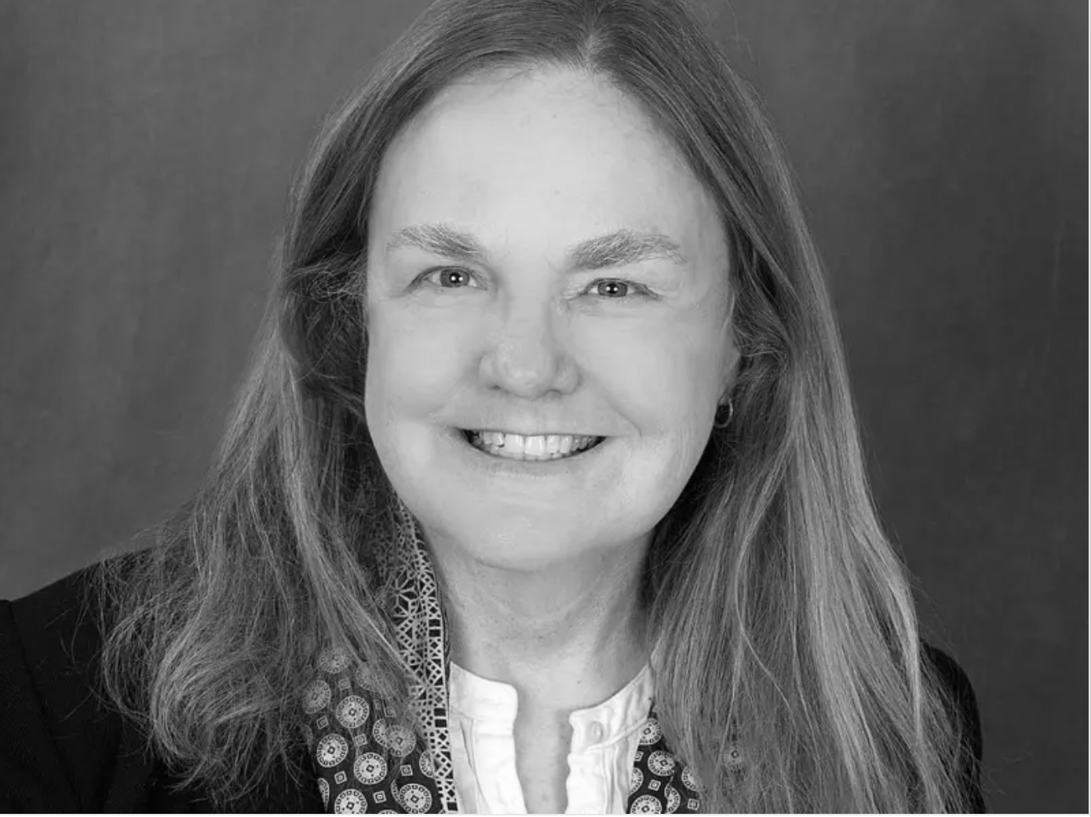
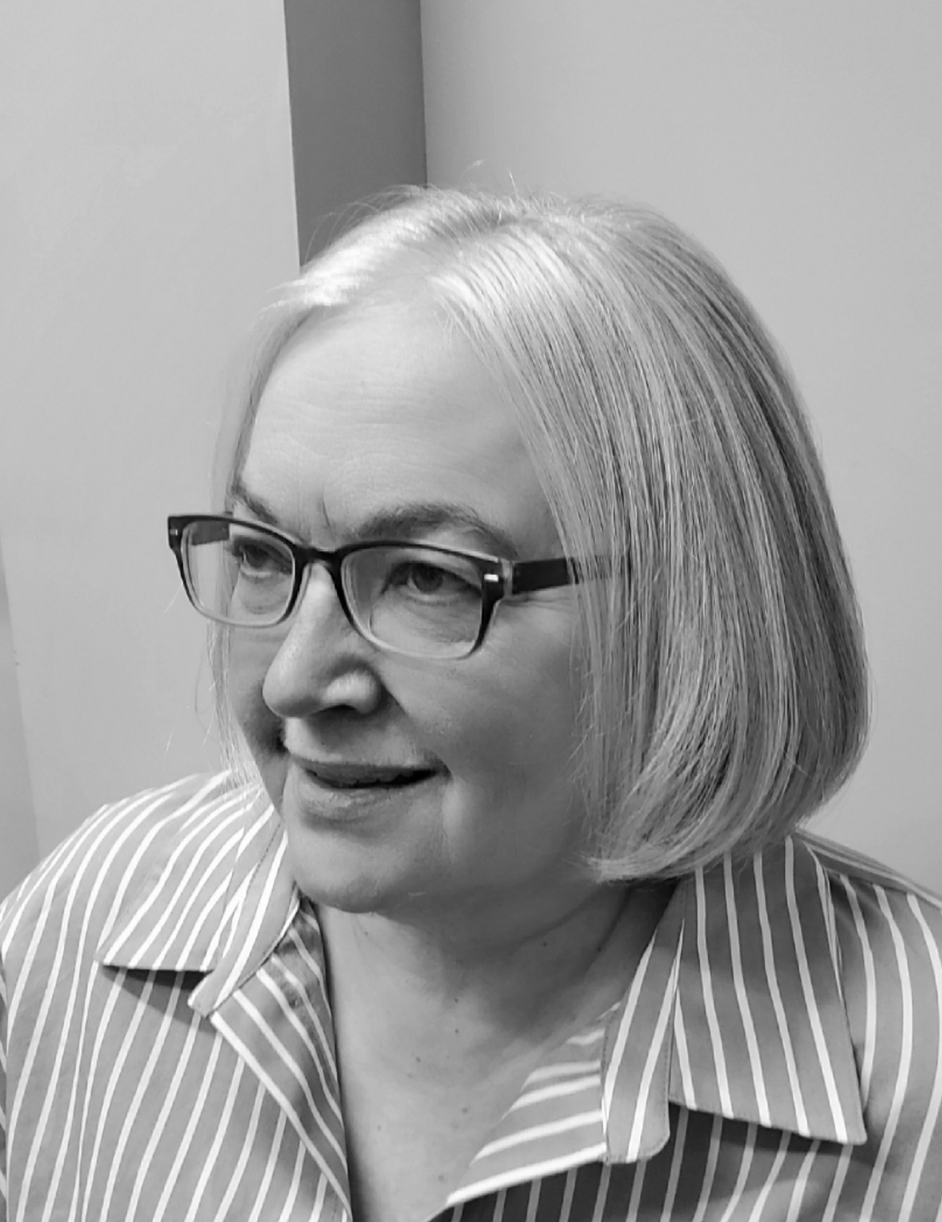
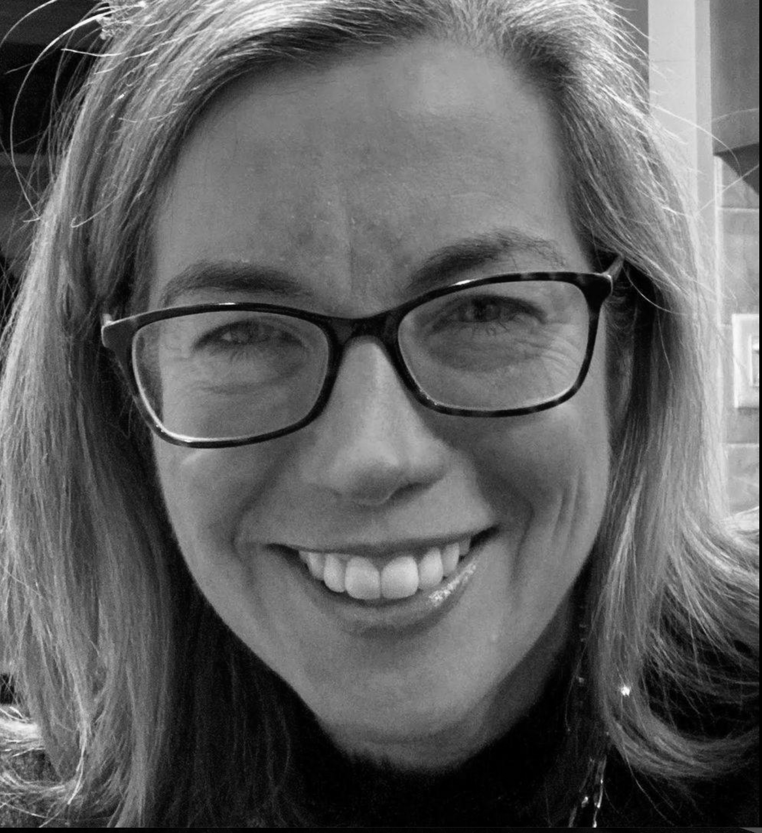
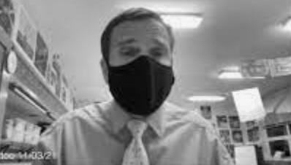
The Team
Dr. Donna McKenzie
Ms. Cathi Collins
Ms. Julie McDonough
Mr. Jefferson Wood
Dr. Anna Nolin

Slide 5
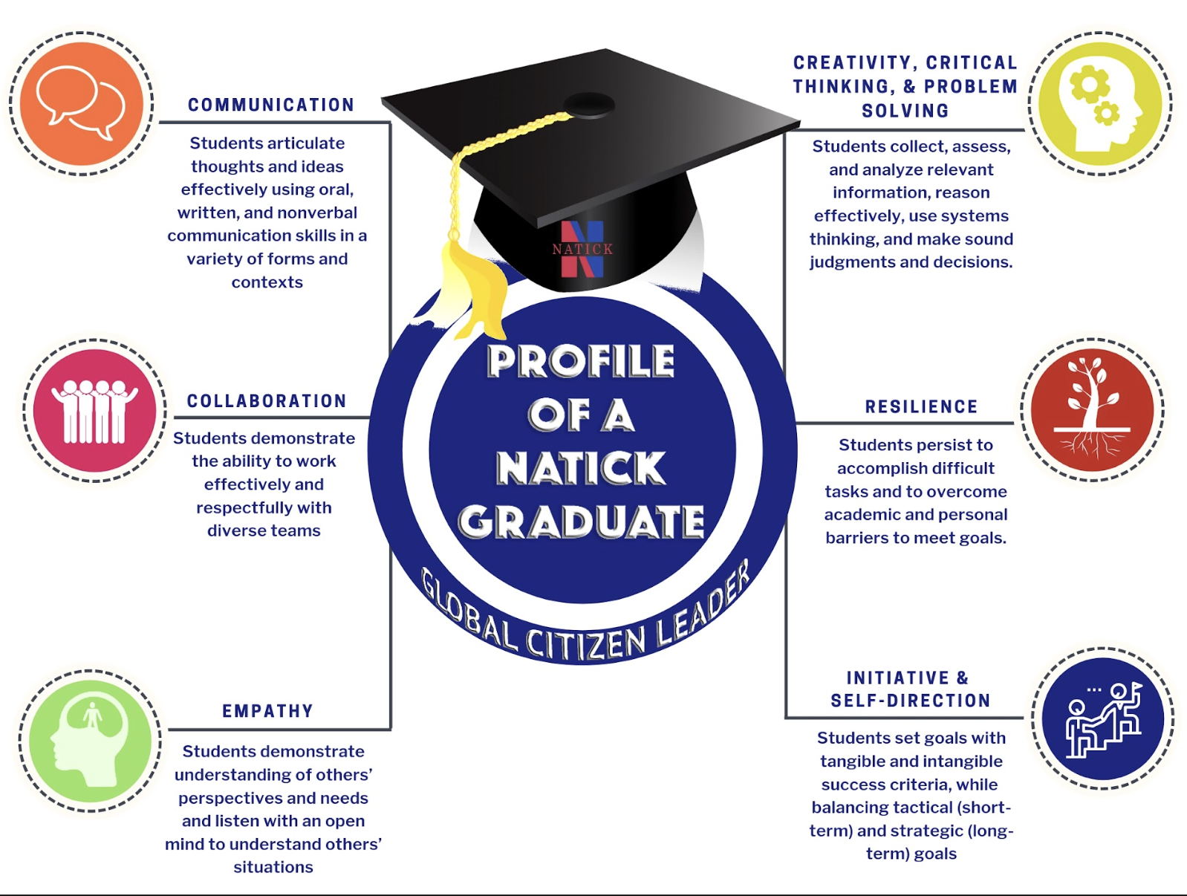

Slide 6
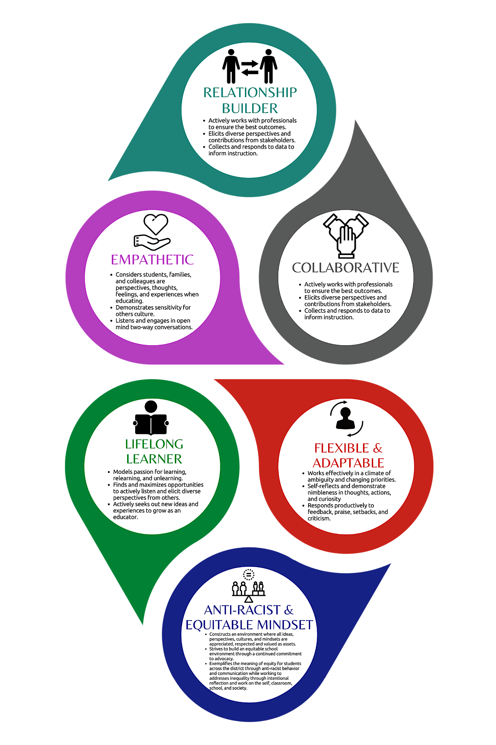
Natick Profile of an Educator
With our profile in mind, we had to lead and negotiate with our values in mind.
Pause: 3 perspectives

Slide 7
When you put on an equity lens, your goals change
The Goals
What is fair becomes the priority , not what each side wants …

Slide 8
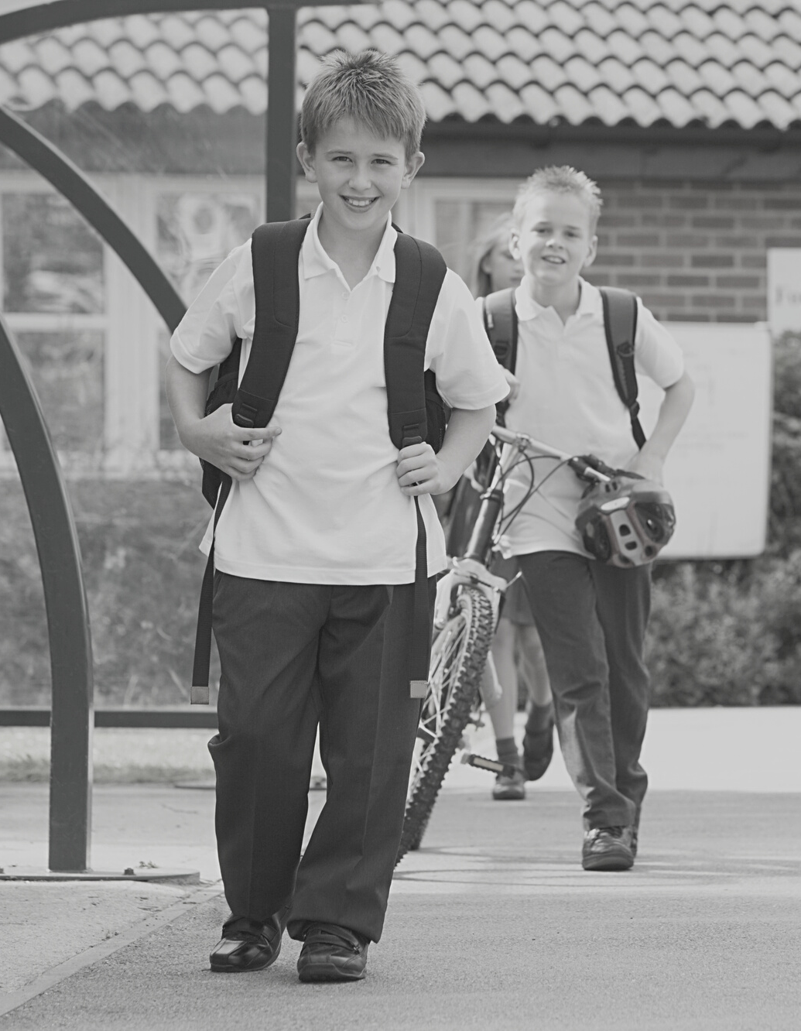
Interest-Based Bargain
Pause: 3 perspectives
What is it?
Interest-based bargaining is a process that enables traditional negotiators to become joint problem-solvers. It assumes that mutual gain is possible, that solutions which satisfy mutual interests are more durable, that the parties should help each other achieve a positive result.

Slide 9
Why use IBB?
Sharing relevant information is critical for effective solutions.
Focus on issues, not personalities.
Focus on the present and future, not the past. Focus on the interests underlying the issues.
Focus on mutual interests, and helping to satisfy the other party’s interests as well as your own.
Options developed to satisfy those interests should be evaluated by objective criteria, rather than power or leverage. R. Schneider testimony resource recommendation 2/19/15 Federal Mediation & Conciliation Services (FMCS) Website

Slide 10
What was different for us this negotiation season?
Less caucusing
Shared priorities not stances
Collective commitment to healing, retaining and joining to honor educators

Slide 11
NPS Negotiations Process
Training in IBB/Refresher (2 sessions)
Set Agenda and Key issues
Ranked key issues in importance and length/complexity
Develop Calendar, Norms, traditions, meals, talking points, sharing
Joint press release, joint writing of the final document HR and EAN, joint/aligned messaging
18 Sessions, with a summary and reflection at end of each one
Notes:
18 sessions + training

Slide 12
Create safe spaces for non-traditional families on staff
Significant examples of that commitment include:
adjusting maternity/FMLA leaves to include language for adoptive, surrogacy, and non-birth parent leaves,
adding accessible professional development opportunities,
creating parent conferences at the middle and high school levels accessible to more parents, and
gaining the EAN’s agreement to the creation of a subcommittee that will explore school start and end times, as well as changes to the elementary school schedules to include school-day professional meeting time.
Key Equity Considerations
Pause: 3 perspectives

Slide 13
Accessible parent conferences for MS and HS
creating parent conferences at the middle and high school levels accessible to more parents,
Consideration of Time Use and Improving Everyone’s Quality of Life
and gaining the EAN’s agreement to the creation of a subcommittee that will explore school start and end times, as well as changes to the elementary school schedules to include in-day meeting time.
Key Equity Considerations
Pause: 3 perspectives

Slide 14
Creation of free EdX coursework for younger/less degreed staff for no cost
Master’s Degree lane was least well compensated and meant we attracted fewer diverse candidates
Harvard/MIT Ed X online course work
Creation of new learning and compensation pathways for long standing vice principals
Ed X for Vice Principals.
Key Equity Considerations
Pause: 3 perspectives

Slide 15
What made this work?
Shifting away from traditional postures (union vs management)
Listening, knitting, creative proposals : Donna’s Superpower
Direct stanceless question asking: Cathi’s Superpower
Parent perspective clarity with deep care for educators: Julie’s Superpower
Leading from a teacher stance while braiding priorities, Anna’s Superpower
The New Generation of Union Leadership story/Leadership Humility of EAN Leadership, Jefferson’s Superpower
Letting go of Start time/Humility of School Committee
.

Slide 16
Summary of Learning and Impact
Better decisions with greater buy-in
Nurtured a new generation of union and administrative experience
Collaborative time EAN, administration and School Committee
None of us can make equitable decisions alone, we must care about equity for staff, students, parents and the community as a package.

Slide 17
Contact Us
Central Office
13 East Central Street, Natick, MA 01760
Phone
(508) 647-6500
Email
email@natickps.org

