Slide 1
Partnering for Family Success
MASS/MASC Panel Presentation,
November 3, 2022
Panelists:
Assabet Valley Collaborative, Cathy Cummins
READS Collaborative, Beth Estrella and Theresa Craig
Northshore Education Consortium, Fran Rosenberg
SEEM Collaborative, Cathy Lawson
Notes:
Cathy C

Slide 2
Why Family Success?
As we emerge from the Pandemic, we are seeing an unprecedented level of need.
Family Success Partnerships and Wraparound Programs provide a cost-effective way to help districts support families and students with the greatest need.
Family Success Partnerships put families at the center, and are able to provide “out of the box” supports that are not typically part of what a district can offer.
Notes:
Cathy C

Slide 3
Collaborative Models of Wraparound Services
are known as:
Bridge Program (SEEM)
Connections Program (NEC)
Family Success Partnership (AVC and READS)
“Comprehensive support models aim to address the out-of-school factors that can impact students’ in-school engagement and readiness to learn.”
Bowden, A.B. & Gish, J.W., Brown Center Chalkboard, 4/26/21
Notes:
Cathy

Slide 4
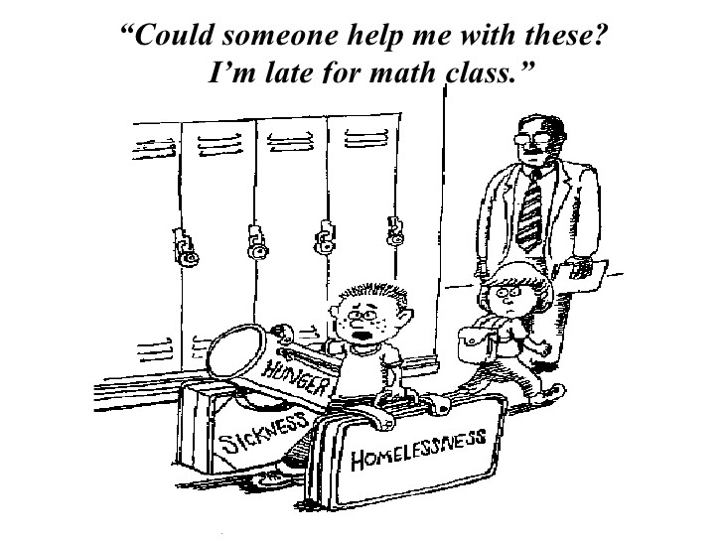
Notes:
Cathy C

Slide 5
Core Elements of the Model
Support for Families
Many families include multiple students in different schools
Link families to community-based support, such as
Counseling/Psychiatric services
Medical care/ Insurance
Housing and essential resources
Legal (domestic, immigration, protection)
Many more you will hear about today
Support for School Personnel:
Ongoing communication & collaboration w/ Administration & Counselors
Resource sharing meetings with Administration and Counselors;
Immediate support with problem solving (e.g., who should we contact? what resources are available?);
Professional Development
Support for Cultural Proficiency & Inclusion
District contracts can range from an individual case (hourly) to 60 cases per year (package).
Notes:
Cathy

Slide 6
Distinctive Services in Partnership
with Families and Districts
Uses a strength-based model to effectively connect students and families with resources in their community
Families establish their goals
Provides an array of flexible services delivered in a space and time that works for each family
Highly individualized to each family to connect them to their school, district, county and community
These services are provided to families in their home district and community and are not connected to services within collaborative programs.
Notes:
Theresa

Slide 7
Distinctive Services in Partnership
with Families and Districts
Relies on a partnership and consultation with school teams.
Incidental Professional Development through Case Management
Formalized Professional Development
Not a Special Education service
Counselor/Social Worker is not a “school” employee.
Services are not a packaged product.
Notes:
Theresa

Slide 8
Distinctive Services in Partnership
with Families and Districts
Highly individualized to each family, school, district, county and community directly connects students and families to the services they need through ongoing support
Care coordination/referrals
Mental Health supports and services
Case Management
“In-home” or “Dunkin Donuts”services
Access to housing, food, basic needs
Builds family autonomy and strengthens school connections in the process
Notes:
Theresa

Slide 9
Bridge Between School Personnel and Families
FAMILY-FOCUSED
PARTNERSHIP
RESOURCES

Slide 10
Panel Perspectives Format
10 Minutes Each
Case Study
Funding Model
Expansion
Unique Features
Notes:
Theresa

Slide 11
Panel Perspective - Flexibility of Services
Assabet Valley Collaborative
Northshore Education Consortium
READS Collaborative
SEEM Collaborative

Slide 12
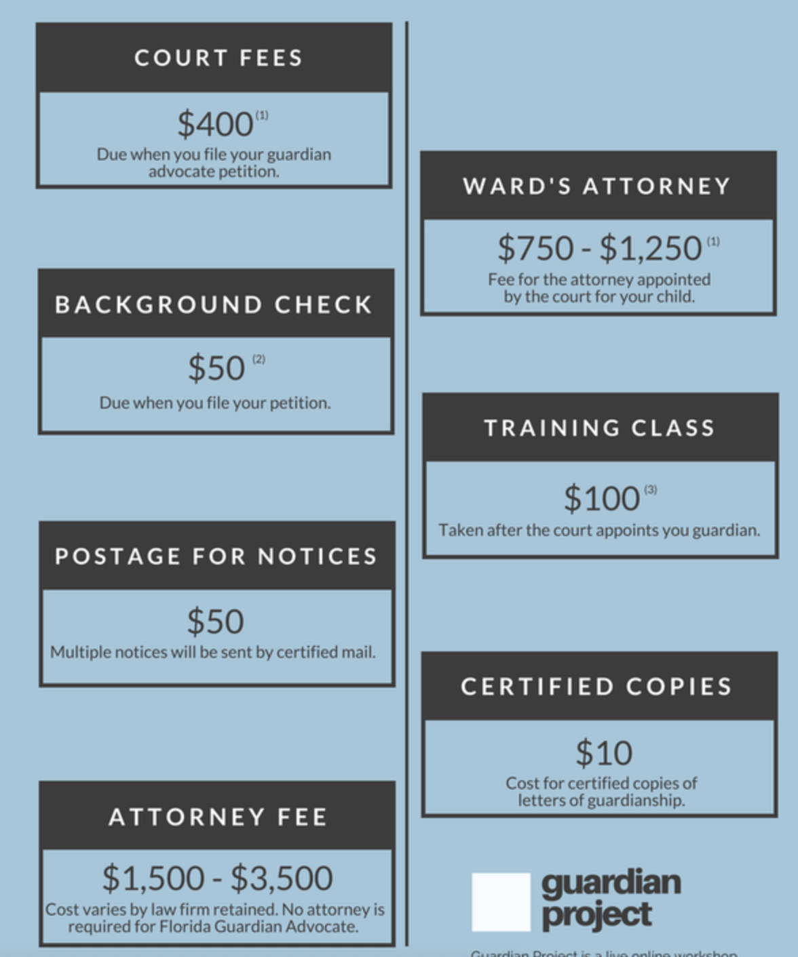
Case Study
Guardianship young adult with severe disabilities:
immigration status
technology
transportation
access to culturally & linguistically responsive services
health insurance
legal services
specialized assessments (psychological, LICSW)

Slide 13
AVC - Funding Model
Packages/Phases of 10 Cases per year - 1-4 cases at a time
$36,750 (Member) $42,000 (Non-Member)
unpackaged: $100/hour (Member) $114/hour (Non-Member)
Partners range from 10 - 30 cases per year (1-12 cases at a time)
Nuances re: caseload complexity, new vs. maintenance cases, etc.

Slide 14
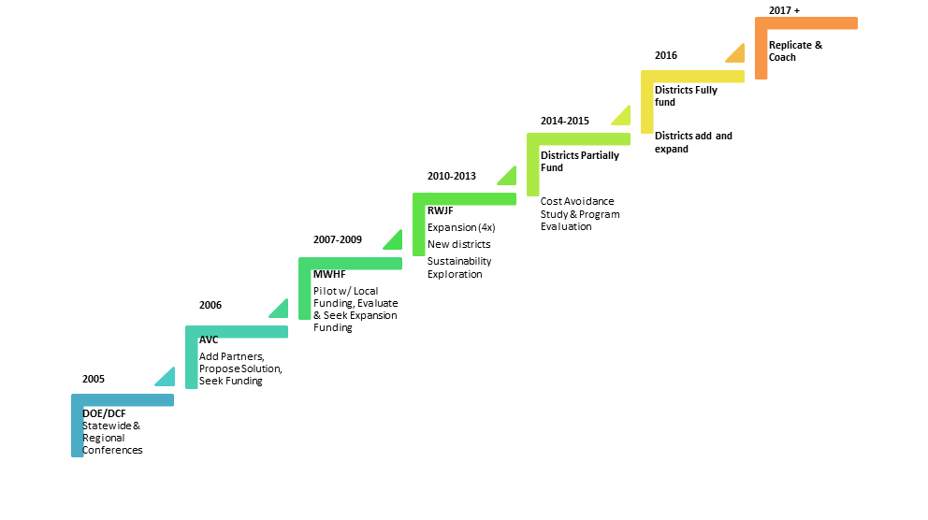
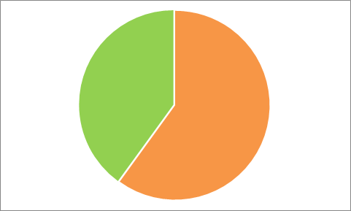
FSP Timeline

Slide 15
AVC - 2022
Director of Family, Community and Employee Engagement
5 Counselors; 1 Resource Navigator; 7 districts (2 -16 years): $650-$700K overall budget
New:
partner with one district to begin direct services to students (grant) & PD to faculty
PD pecializations: QPR, Mental Health 101, Storytelling/Narrative, Cultural Proficiency, Guardianship, Immigration
partner with one district to support in-district wraparound
mentoring, coaching, supervision
more complex cases still to AVC

Slide 16
AVC - Unique Features
Cultural Proficiency & Cultural Responsiveness as priorities - foundational
Shared leadership in organization and in team (in design)
Case rotation and diversity - obligation to build our individual and collective capacity to serve all
Multi-lingual counselors and resource navigator (Portuguese and Spanish)
Tiered Replication & Mentorship to support startup elsewhere
Pilot of direct service to students to fill current gaps in system
Strengths in complexities: mediation, medical complexity, immigration, housing, health insurance, terminal illness/death of guardians, guardianship, etc

Slide 17
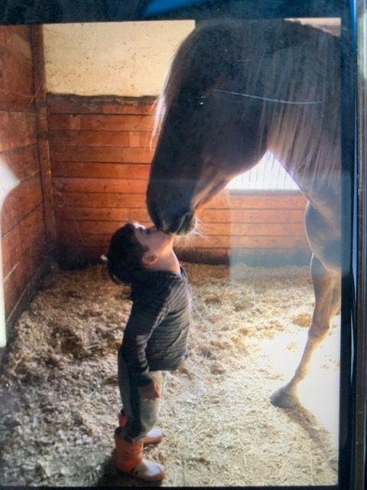
NEC - Case Studies
Parent Suicide…multiple siblings impacted by sudden loss, trauma. Surviving parent had limited English skills and was unprepared to deal with resulting issues with insurance, housing, technology, medical care (school information - IEP’s, etc and Finances) .
Multi-Generational Trauma….
Successful graduation
Dis-regulated Kindergarten Student…
Prevention of Out-Placement

Slide 18
NEC - Funding Model
Private grant funding (Tower Foundation, Essex County Community Foundation) enabled us to offset costs in the first year, and to expand prior to obtaining district commitments.
Districts can contract for the year or pay fee for service.
For $25,000 our clinicians can work with two high needs cases at any time throughout the year, and be available for additional consultation as needed.
For $40,000 our clinicians can work with four high need cases at any time throughout the year, and be available for additional consultation as needed.
Customized contract plans can be created that would additionally incorporate professional development/trainings and consultation on student mental health and trauma related issues. These plans can be individually crafted to the specific needs of your district.
Purchase specific services at an hourly rate of $140 for member districts or $175 for non-member districts.

Slide 19
NEC - Expansion
Year | Referrals | Number of Districts | Other Comments
2019 Pilot | 16 | 5
2019-2020 | 25 | 9
2020-2021 | 29 | 8
2021-2022 | 48 | 9 | Districts requesting PD
2022-2023 | 23 (in 2 months) | 7 | Two districts didn’t renew contract but are purchasing as needed. Several districts increased the level of their contract. Three new districts are considering joining. More PD is being requested.

Slide 20
READS - Case Study
Initial Referral: Student was nearing graduation, lacked a post-graduation plan, and his school performance was declining. School team was unsure of cause of shift in this student’s presentation and parent was not responsive to school’s outreach.
Unidentified barriers:
Family lacked basic resources (beds, furniture, heat, etc.) & did not seek assistance with these needs due to fear of judgement.
Parental lacked knowledge of systems of support for her son post graduation and possessed limited skills to independently navigate systems
Outcomes with FSP Support:
FSP clinician connected with community resources to provide family with beds, mattresses, furniture, heating assistance, and food assistance.
Connected student with MassRehab
Empowered mother to become self-reliant and capable of navigating systems to provide for her self and family

Slide 21
READS - Funding Model
District Funded through purchase of Family Slots for the school year.
FSP clinicians tailor each family slot to meet student & family needs through:
Regular meetings, consultation, & collaboration with school team
Visits/phone calls/check-ins with family & students as often as needed to stabilize family
Individual and family counseling
Connecting families to various professional, informal, and community resources
Supporting families with immigration, housing, hospitalizations, re-entry to school, etc.
Professional development, skill building, and resource sharing with school and district teams.
Family slot costs are listed below.
Districts with 5 or more families are able to add slots individually at a prorated rate and/or Extended School Year services at an hourly rate.
5 Families - $18,200
10 Families - $33,800
15 Families - $48,800
30 Families - $98,280

Slide 22
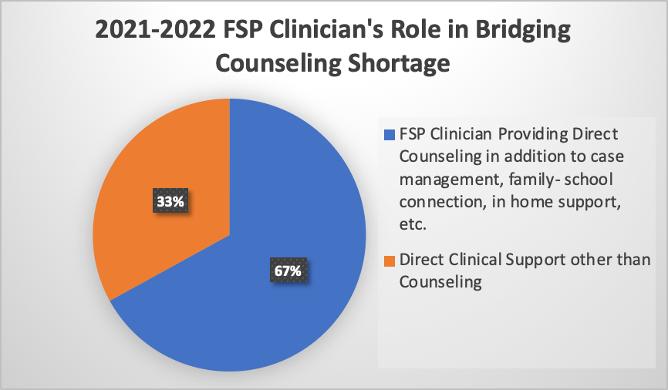
Meeting the Needs Resulting from the Pandemic - 21-22 School Year - Increasing Mental Health supports
READS Data
Notes:
Beth

Slide 23
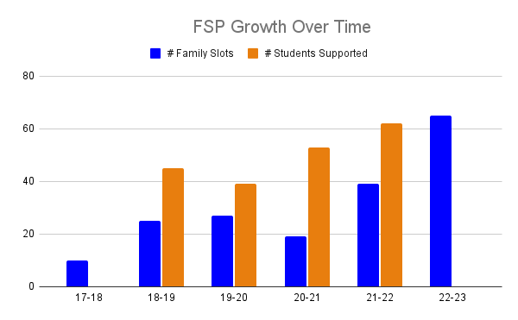
READS - Expansion
2017-2018
1 Part-time FSP Clinician
10 Family Slots
2 Districts
2022-2023
4 FSP Clinicians
75 Family Slots
7 Districts

Slide 24
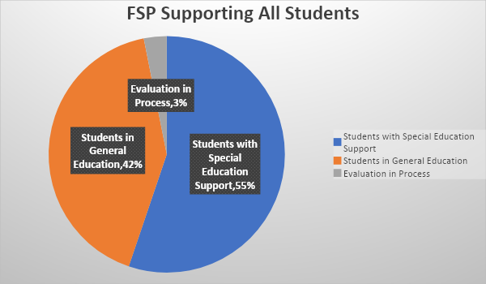
READS data FY 22
Notes:
Beth

Slide 25
READS - Unique Features
READS FSP Clinicians engage in monthly meetings with READS Deaf and Hard of Hearing and READS Academy clinicians to share resources across the state for all students at READS, in addition to case consultations, and professional development
FSP clinicians coach districts’ staff in skills taught to each family to support carryover of skills for students and families
READS FSP program uses data collected each year (family/school themes, areas of support provided, goal attainment, etc.) to provide targeted professional development and adjust practice.
Collaboration with AVC, NEC, and SEEM resulted in SCRO supporting timely professional development for school staff across the state with “Tackling School Avoidance: Strategies for Getting Anxious and Disconnected Students Back in the Building” with Lynn Lyons

Slide 26
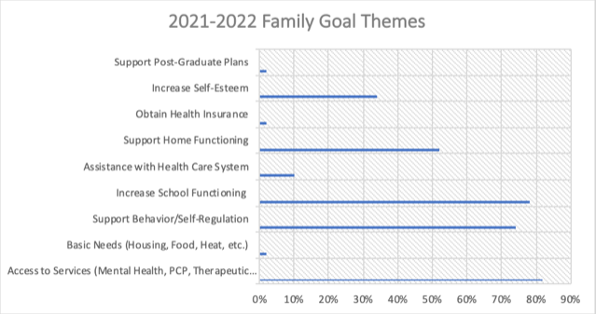
Notes:
Beth:
In FY20 Access to Services Theme was 36%. In FY22, it more than doubled to 83%, with the majority being access to mental health

Slide 27
SEEM - Case Study
Providing Family and School Support
Needs Assessment: Trauma during school at elementary level was disclosed in 9th grade of high school. Student was chronically absent and medically excused for a quarter in the 9th grade. In their 10th grade year, a referral was submitted for a Needs Assessment.
Recommendations: Parent Consultation, Case Consultation with the school, and occasional student counseling and morning support to school.
Plan: Work began with preparing the student to re-enter school, consultation and counseling was provided and the goal was to reduce hospitalizations, increase school attendance, and repair the family’s trust with school as a result of the trauma.
Outcomes:
The student had three hospitalizations in 9th grade, two in the 10th grade, and after three years of SEEM support, as well as attending outpatient individual therapy, the student had zero hospitalizations in their senior year and successfully graduated high school.
The student has been successfully employed since graduating high school.

Slide 28
SEEM - Funding Model
Fee for Service Model, $133 per hour members, 162 per hour non-members
Case Consultation (either for a specific student, global concern or classroom) Observation (when appropriate) and consultation and capacity building for school based staff on social emotional needs of student(s)
Needs Assessment/Referral for Services (home visit with family, assessment of needs, written recommendations, referrals for services initiated)
School Refusal Assessment and Intervention: (home visit with student and family, interviews with school staff and outside providers, recommendation and delivery of services to increase school attendance)
School Refusal Intervention CBT and Supportive Parenting for Anxious Childhood Emotions (SPACE)
School Based Direct Services (Individual Counseling, Crisis Intervention or pre-screening)
Short Term Family Stabilization (ongoing) In home wraparound support for families in crisis either as a bridge until insurance based services are available or due to ineligibility for insurance based services
Ecological Assessment (comprehensive written report of bio psychosocial assessment of student and family functioning with recommendations)
Notes:
School Refusal Intervention:

Slide 29
SEEM - Expansion
Shift from emergency driven home/school based assessments with recommendations to:
Direct Counseling for students who are not able to access mental health support in their community
Cover partial to full caseloads due to School Psychologist medical leave or unfilled positions due to School Counselor and Psychologist shortage
School Refusal/Avoidance Assessments/Implement support plan
Parent training series of support and training during COVID/remote learning times
Referral Trends:
2018-2020 - 60 students serviced annually
2020-current: number of students serviced decreased to 30
staffing shortage reduced capacity
referrals have increased over time
Current Waitlist: 1
1 School Refusal Assessments,
4 Needs Assessments,
2 Ecological Assessments and
2 family stabilizations.
Consistent waitlist since 2018

Slide 30
SEEM - Unique Features
SEL Grant
2021/2022 SEEM was awarded $42,500 through grant code 613/311
direct work with students through an afterschool program that targeted students who were less likely to be able to attend programs in their community due to economic or behavioral factors. 12 students attended an 8 week program in the Spring of 2022.
professional development was delivered to SEEM staff that focus on childhood/adolescent anxiety
outreach was provided to families in their homes or community locations afterschool and on weekends to help them access community resources and services
biofeedback tools were purchased and used with our SEL program students
2022/2023 SEEM was awarded $50,000 and will continue with the described services above increasing out afterschool program to 18 weeks and up to 36 students.

Slide 31
Distinctive Services to Districts and Families
are Evolving Continuously
Increasing need
need for individual check-ins
interim services
gaps in provision of services
Complexity of services increasing as districts adopt practices internally.
Outlier cases are becoming more common
Increased percentage of goals are focused on Mental Health of child or family member
Notes:
Fran or Cathy Lawson?

Slide 32
Q and A
Thank you!
Additional resources and references are including in the slides that follow.

Slide 33
“This integrated model has been found to significantly improve student academic and social-emotional outcomes, particularly for low-income, Black, Latino, and immigrant students.”
Bowden, A.B. & Gish, J.W., Brown Center Chalkboard, 4/26/21
“... Well-coordinated, thoughtful wraparound services often allow a student to avoid residential placement, continue to be educated in the least restrictive environment, and continue to reside within the home.” Paige Tobin, Attorney - Wrap-Around Services - Case Law Summaries, 9/22/2014
Small investments for big gains: Transforming wraparound services into an engine of opportunity
Notes:
Cathy Cummins - wide body evidence - Theresa?

Slide 34
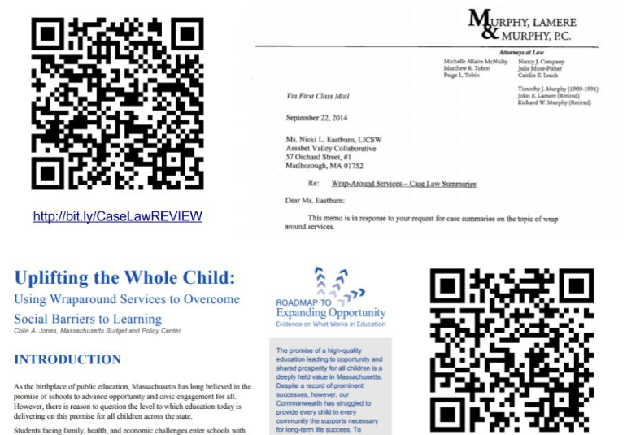
Making the Case for District Funding as Vital to Inclusion
Notes:
cc: I recommend Theresa for this?)

Slide 35
Examples:
Community Resource Connection: 5 year old boy at risk of referral to OOD placement. Clinician worked with parent, consulted to school team, and helped child access a referral for equine therapy.
Support to Parent in Crisis: 17 year old boy at risk of dropping out in senior year. Helped parent find therapist and get a new job, helped team understand multi-generational trauma and mental health issues; student on track to graduate
Housing and Food Insecurity: 16 year old girl w/ anxiety, depression and drug use: Helped family with housing and food supports, drive-by visits during pandemic; student is now is attending school regularly and has a job.

